Slide 1
A Comprehensive Approach to Vulnerability Risk Management
The joint value of Rapid7’s best-of-breed vulnerability management and application security solutions

Slide 2
The Challenges of VRM in Today’s Security Landscape
Security teams have more on their plates than ever before, tasked with managing and reducing risk across an ever-growing and changing attack surface.
Our scope has grown past just critical servers to include local and on-premises infrastructure, cloud-based and virtualized assets and services, and even applications—historically requiring us to juggle multiple point solutions.
But attackers aren’t siloed in their approach to exploitation, so we can’t be siloed in our approach defending against them.

Slide 3
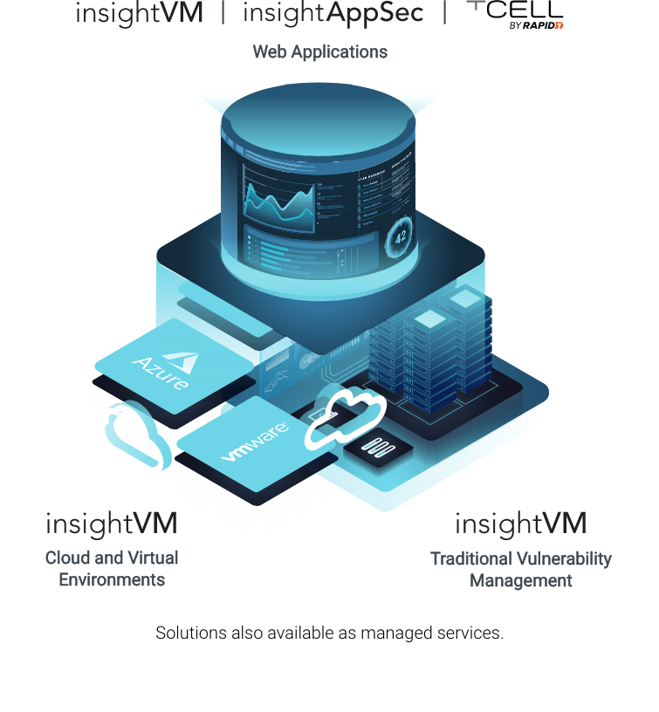
Rapid7 Solutions for Vulnerability Risk Management
Rapid7 offers industry-leading solutions that provide visibility and control over the complete attack surface, from the infrastructure to the application layer.

Slide 4




Value at a Glance
Convenience of working with a single vendor on a unified platform, from procurement to ongoing support and training
Shared reporting across best-of-breed solutions gives CISOs and leadership a holistic picture of vulnerability risk
Ease-of-use and reduced learning curve from solutions with a consistent interface and overall in-product experience
Technology and approach built for collaboration with IT Ops and DevOps teams to eliminate weaknesses and vulnerabilities

Slide 5

Supporting the Case
Talking Point #1: Motivated attackers will try and find any path into our network, and vulnerability exploitation can happen indiscriminately across the different layers of our attack surface.
With web applications consistently the #1 attack vector for data breaches, it makes sense to include them as part of the scope of a larger vulnerability risk management strategy—our technology should support that.

Slide 6


Supporting the Case
Talking Point #2: Rapid7 is the only vendor in the market with analyst-recognized solutions in vulnerability management and application security, not to mention leadership status in both.
If we’re already doing vulnerability management in its traditional sense, Rapid7 is the ideal partner for expanding our scope to applications: They offer appsec solutions for a range of maturity levels and organization sizes—all of which are trusted and validated in the market.
Let’s dive into those options.

Slide 7
Supporting the Case
Talking Point #2 (continued): InsightAppSec, Rapid7’s application testing solution, has been the highest rated DAST three years in a row.
InsightAppSec is designed to get teams deployed and scanning quickly to identify pressing vulnerabilities and weaknesses in their applications, such as the OWASP Top Ten.
For teams with extensive background in application security, InsightAppSec supports all modern application frameworks and formats, and advanced crawling and testing is made possible with 100+ attack modules.
InsightAppSec can also be augmented by tCell, Rapid7’s monitoring and protection solution that monitors and blocks attacks against application vulnerabilities as they happen.

Slide 8
Supporting the Case
Talking Point #2 (continued): For teams who don’t have the resources or expertise to run their DAST technology in-house, Rapid7 is also a market leader for its Managed Application Security (AppSec) service.
Managed AppSec offloads the day-to-day operationalization and scanning of InsightAppSec to Rapid7’s team of experts, so our team can focus on overall VRM strategy and program development.
With intimate knowledge of the risk management and reduction needs for our unique organization, Rapid7’s Customer Advisor team can provide guidance and articulate the business impact of our VRM efforts.

Slide 9






Supporting the Case
Talking Point #3: Rapid7 understands that real impact is made through risk reduction and remediation, which can also be a source of friction between Security, IT, and DevOps teams.
Rapid7’s extensive partner ecosystem and technology integrations allow us to integrate into the workflows and systems already leveraged by our operational counterparts, improving the collaborative process and relationship.

Slide 10
Looking Ahead
Rapid7 continues to invest in its efforts to be the best partner in the market for vulnerability risk management. These areas include:
More ways to share and correlate data across its VRM solutions
Expanding its existing visibility and assessment capabilities for the cloud
Expanding its existing visibility and assessment capabilities for containers and container orchestration
Reach out to the Rapid7 team for more information.

Slide 11
Thank you
Questions?
Reach out any time to your Rapid7 Account Executive or Customer Success Manager, or email sales@rapid7.com.

